Slide 1
Gaussian Processes
Idea
Stochastic regression based on Gaussian functions

Slide 2
Gaussian Processes
Most geophysical processes are not deterministic
Need some representation of the noise
Uncertainty quantifications
→ Gaussian Processes (random/stochastic processes)

Slide 3
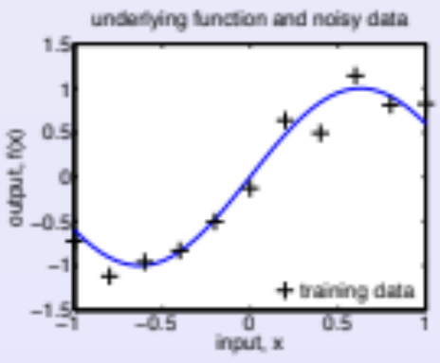
Gaussian Processes
Supervised learning: Regression
Assume an underlying process which generates “clean” data.
Goal: recover underlying process from noisy observed data.

Slide 4
Gaussian Processes
Supervised learning: Regression
Training data are D = {x(i),y(i) | i = 1,...,n}
Each input is a vector x of dimension d.
Each target is a real-valued scalar y = f (x) + noise.
Collect inputs in d × n matrix, X , and targets in vector, y :
D = {X , y}.
Wish to infer f ⋆ for unseen input x⋆, using P(f ⋆|x⋆, D).

Slide 5
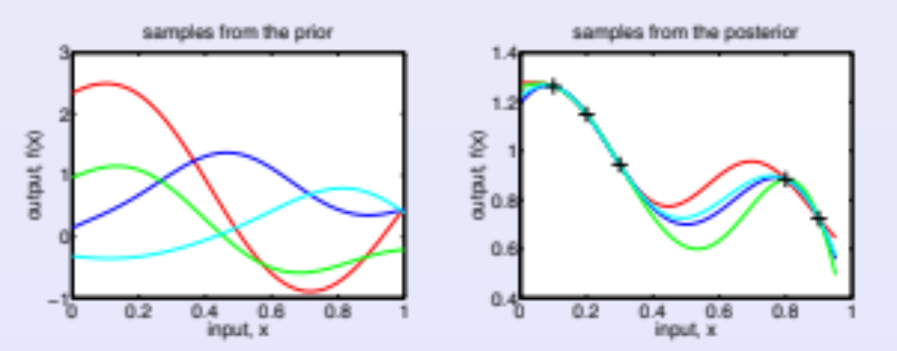
Gaussian Processes
Gaussian Process Models: Inference in Function Space
A Gaussian process defines a distribution over functions.
Inference takes place directly in function space.

Slide 6
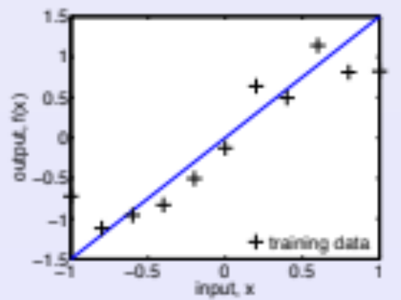
Linear regressions
Bayesian Linear Regression
Assuming noise ε ∼ N (0, σ²), the linear regression model is:
f(x|w)=x⊤w=∑x_{i}w_{i} (w: weights)
y=f+ε.

Slide 7
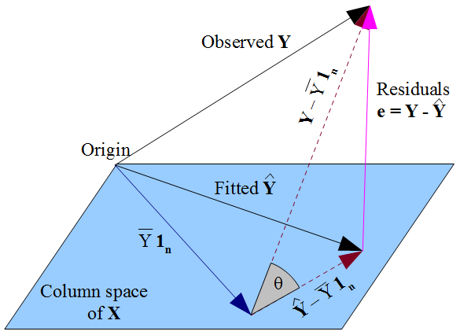
Linear regressions
Solution as projection into Span(1,x) subspace
=[1,x]^{T}Y
Not a minimum
if not projection

Slide 8
Linear regressions
Bayes’ theorem - posterior relates to prior
P(A|B) = P(B|A).P(A) / P(B)
As
P(A|B).P(B) = P(A and B) = P(B|A).P(A)

Slide 9
Linear regressions
Bayesian Linear Regression
Likelihood of parameters is:
P(y|X,w) = N(X⊤w,σ²I).
Assume a Gaussian prior over parameters:
P(w) = N(0,Σ_{p}).
Apply Bayes’ theorem to obtain posterior (weights/parameters):
P(w|y,X) ∝ P(y|X,w)P(w).
Prior

Slide 10
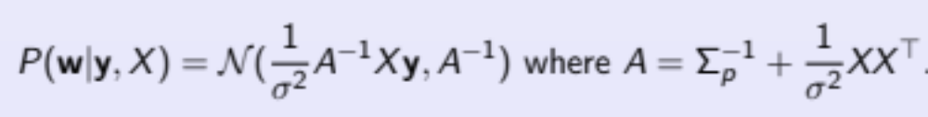
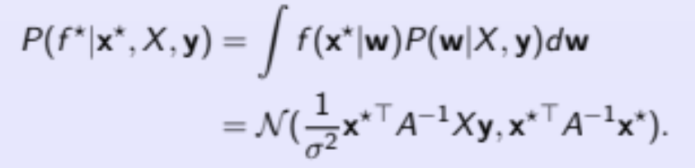
Linear regressions
Bayesian Linear Regression
Posterior distribution over w is:
Predictive distribution is:

Slide 11
Beyond linear regressions
Projection
Use a set of basis functions Φ(x) to project a d dimensional input x into m dimensional feature space:
e.g. polynomial functions Φ(x) = (1,x,x²,.., x^{m}) → projection onto this feature space
P(f⋆|x⋆,X,y) can be expressed in terms of inner products in feature space:
One trick: we can use kernels to approximate it (see later)
Question: How many basis functions should we use?

Slide 12
Gaussian Process: definition
Definition
A Gaussian process is a collection of random variables, any finite number of which have a joint Gaussian distribution.
Consistency/marginal distribution:
If the GP specifies y⁽¹⁾,y⁽²⁾ ∼ N(μ,Σ), then it must also specify y⁽¹⁾ ∼ N(μ₁,Σ₁₁):
A GP is completely specified by a mean function μ and a positive definite covariance function Σ (between y^{(i)},y^{(j)}).

Slide 13
Gaussian Process: definition
Distribution over functions
e.g. Choose mean function zero, and covariance function:
K_{p,q} =Cov(f(x^{(p)}),f(x^{(q)}))=K(x^{(p)},x^{(q)})
For any set of inputs x⁽¹⁾, . . . , x^{(n)} we may compute K which defines a joint distribution over function values:
f(x⁽¹⁾),...,f(x^{(n)}) ∼ N(0,K).
Therefore, a GP specifies a distribution over functions.

Slide 14
Gaussian Processes
Simple example
Can obtain a GP from the Bayesian linear regression model:
f (x) = x⊤ w with w ∼ N (0, Σ_{p} ).
Mean function is given by:
E[f (x)] = x⊤E[w] = 0.
Covariance function is given by:
E[f (x)f (x′)] = x⊤E[ww⊤]x′ = x⊤Σ_{p}x′.

Slide 15
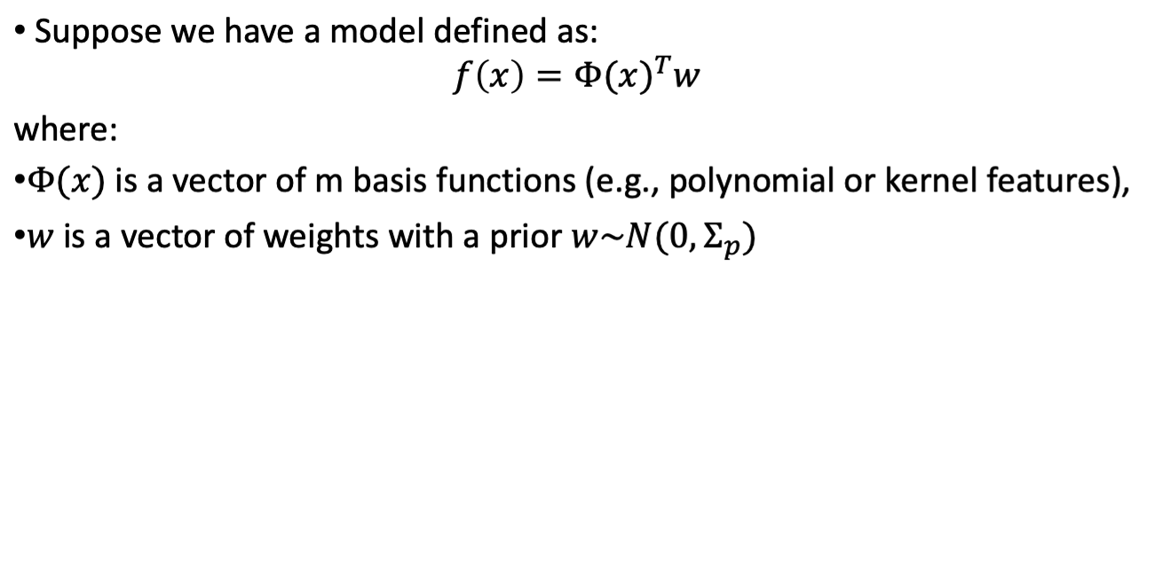
Gaussian Processes

Slide 16
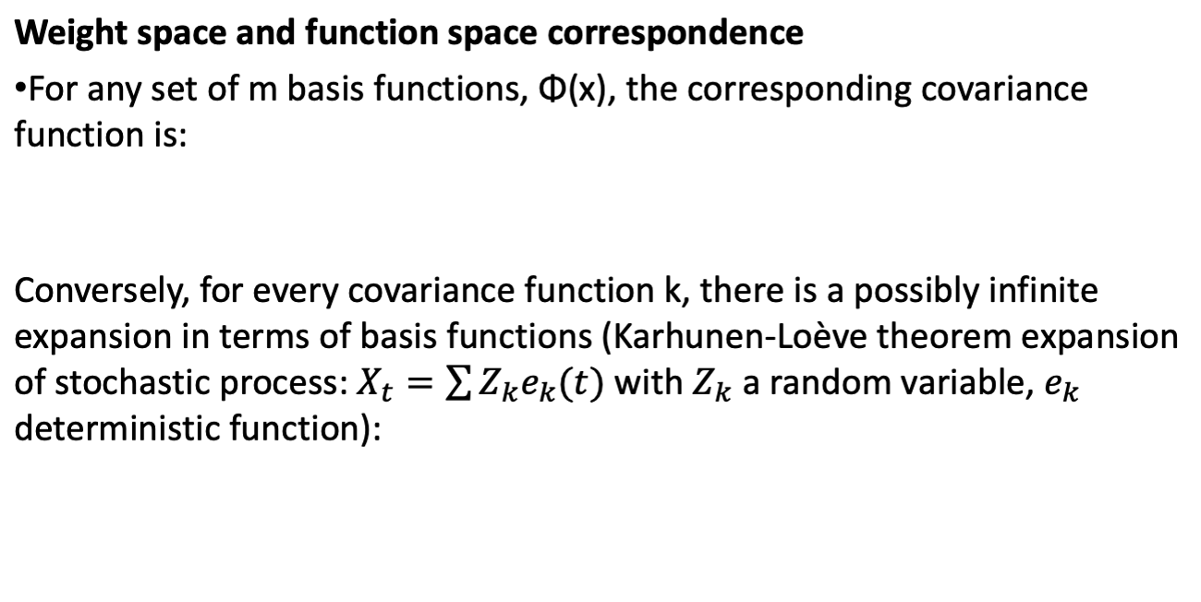
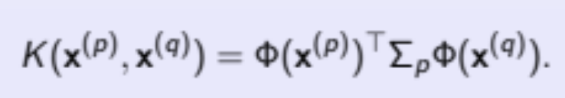
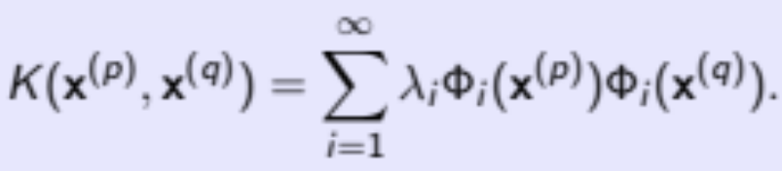
Gaussian Processes

Slide 17
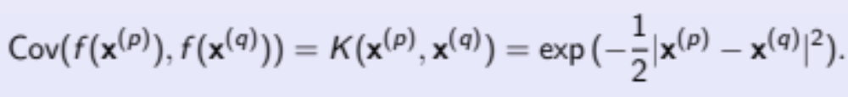
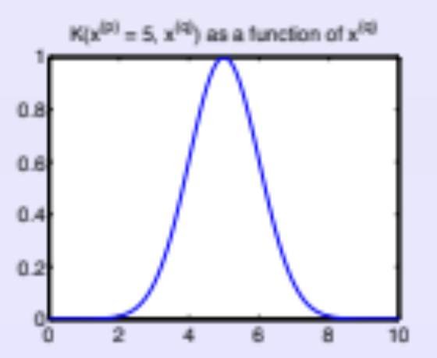
Gaussian Processes
Covariance function
Specifies the covariance between pairs of random variables.
e.g. Squared exponential covariance function:
Translation invariant!

Slide 18

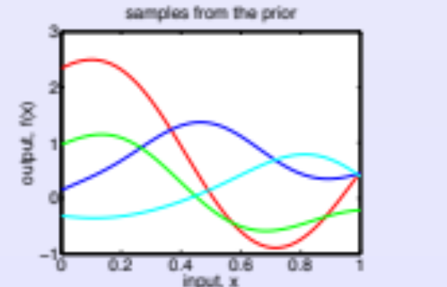
Gaussian Processes
Gaussian process Prior
Given a set of inputs x⁽¹⁾, . . . , x^{(n)} we may draw samples f (x⁽¹⁾), . . . , f (x^{(n)}) from the GP prior
Four samples:

Slide 19
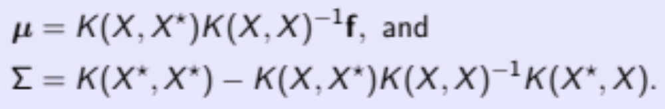
Gaussian Processes
Posterior: Noise-free Observations
Condition {X⋆,f⋆} on D = {X,f} obtain the posterior.
Restrict prior to contain only functions which agree with D.
The posterior, P(f⋆|X⋆,X,f), is Gaussian with:

Slide 20
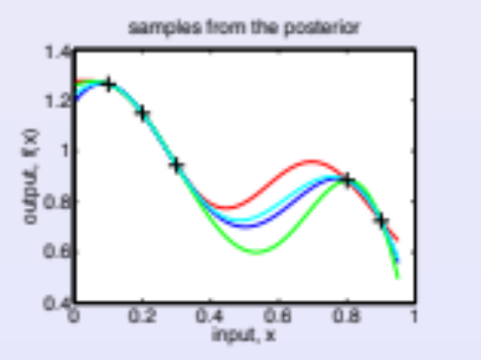
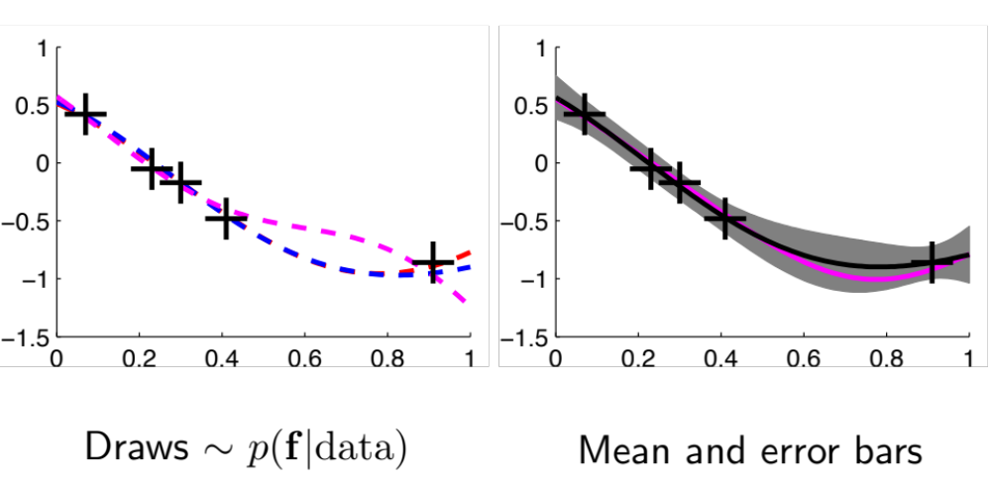
Gaussian Processes
Posterior: Noise-free Observations
Samples all agree with the observations D = {X,f}.
Greatest variance is in regions with few training points.

Slide 21
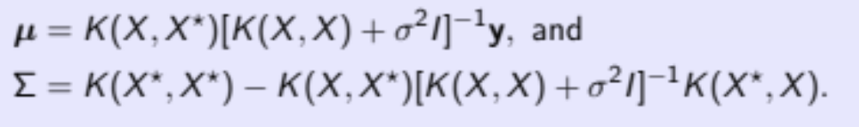
Gaussian Processes
Prediction: Noisy Observations
Typically we have noisy observations:
D={X,y}, where y=f+ε
Assume additive iid noise ε ∼ N (0, σ²I ).
Conditioning on D = {X , y} gives a Gaussian with:

Slide 22
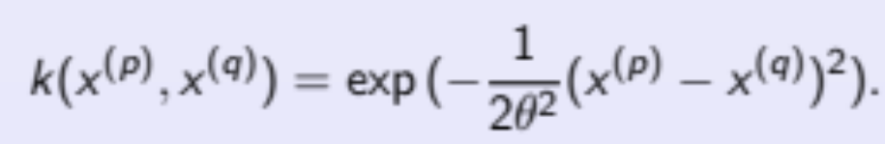
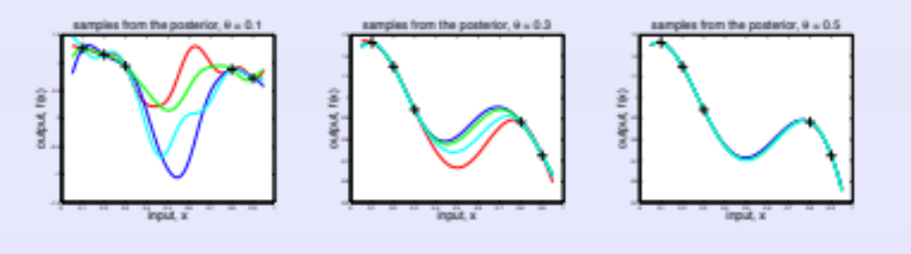
Gaussian Processes
Model selection: hyperparameters (same as NNs)
E.g. the ARD covariance function
How best to choose θ?

Slide 23
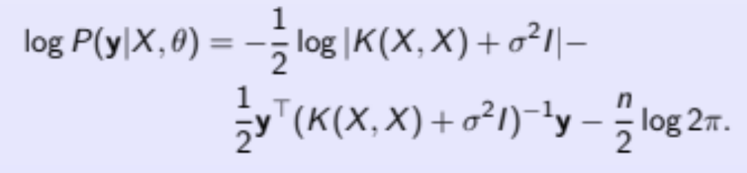
Gaussian Processes
Model selection: hyperparameters
In absence of a strong prior P(θ), the posterior for hyperparameter θ is proportional to the marginal likelihood:
P(θ|X,y) ∝ P(y|X,θ)
Choose θ to optimize the marginal log-likelihood:

Slide 24
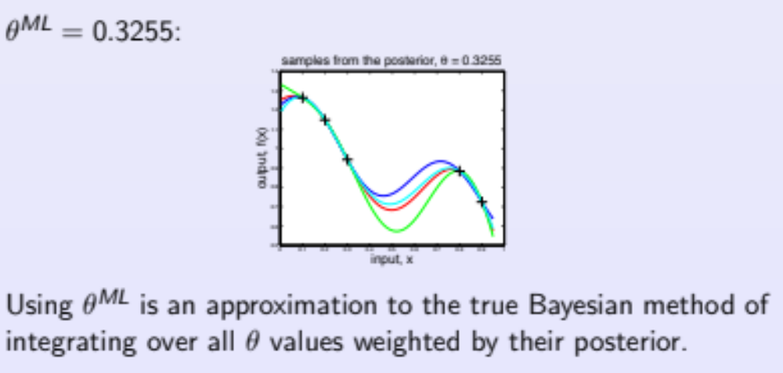
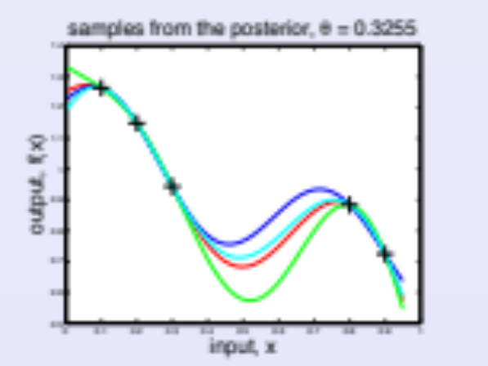
Gaussian Processes
Model selection: hyperparameters

Slide 25
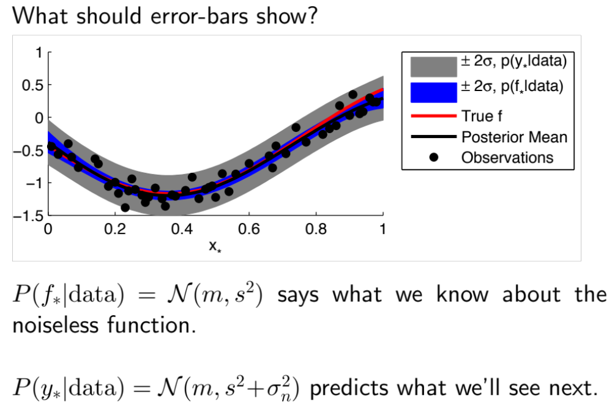
Gaussian Processes
Discovery or prediction

Slide 26
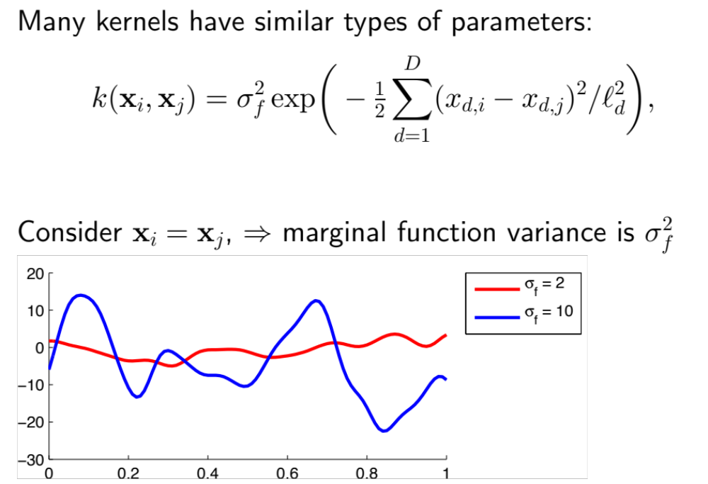
Gaussian Processes
Kernels

Slide 27
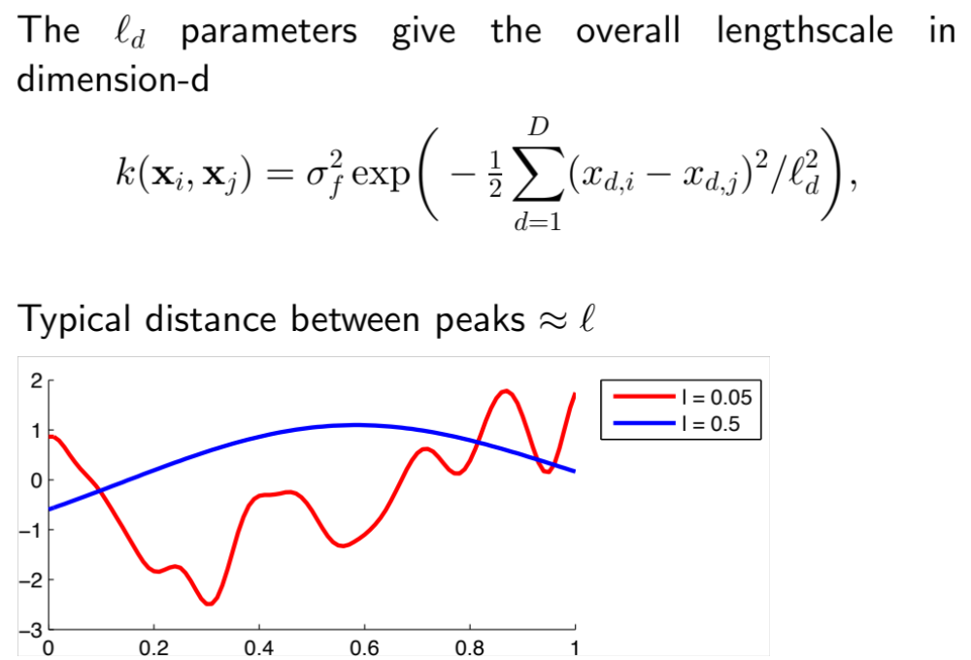
Gaussian Processes
Kernels

Slide 28
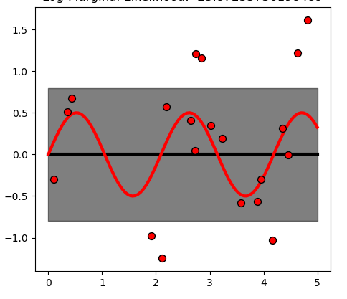
Gaussian Processes
Example of Kernels
Constant kernel
k(x_{i},x_{j}) = constant
The main use-case of the constant kernel is that it explains the noise-component of the signal. Tuning its parameter corresponds to estimating the noise-level

Slide 29
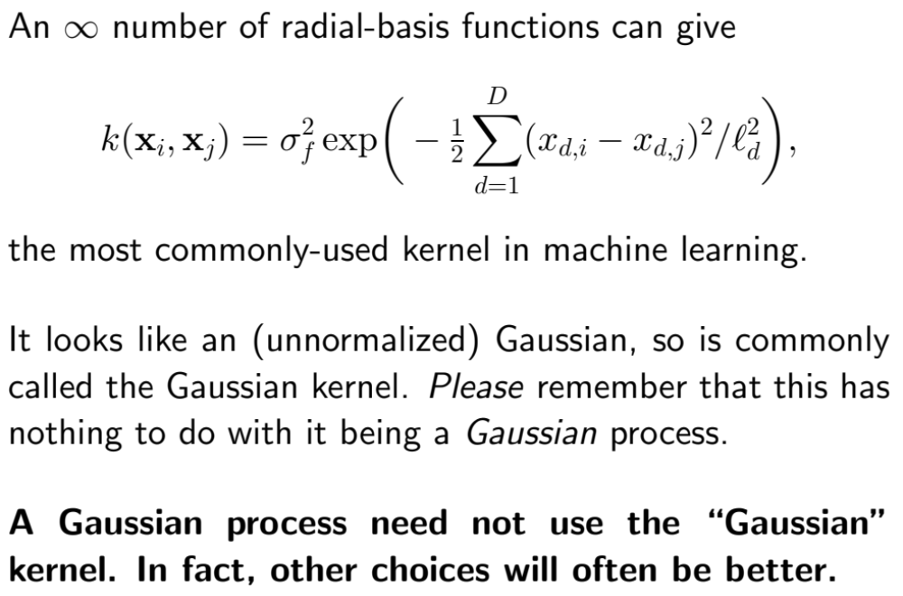
Gaussian Processes
Example of Kernels
Squared exponential kernel

Slide 30
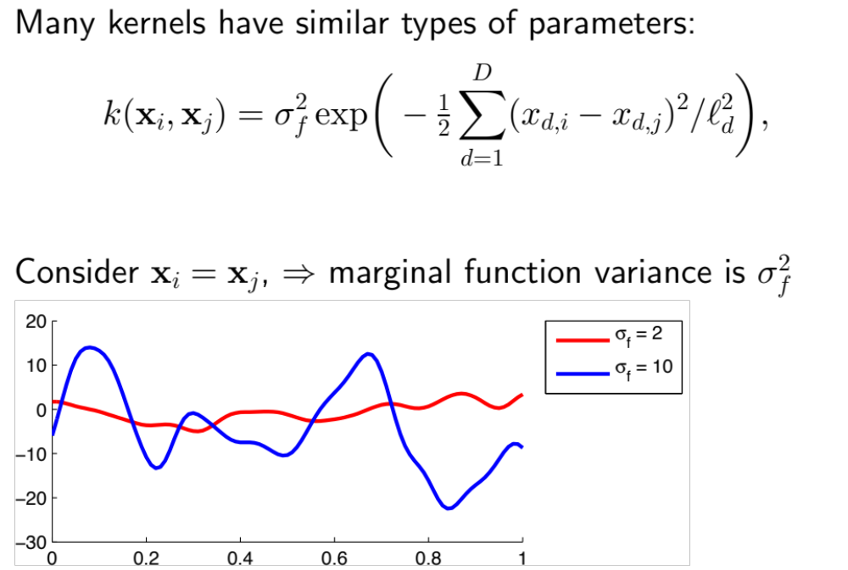
Gaussian Processes
Example of Kernels
Squared exponential kernel

Slide 31
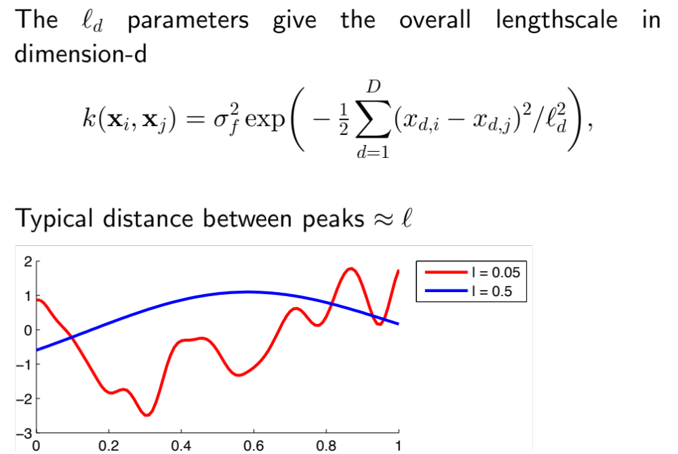
Gaussian Processes
Example of Kernels
Squared exponential kernel

Slide 32
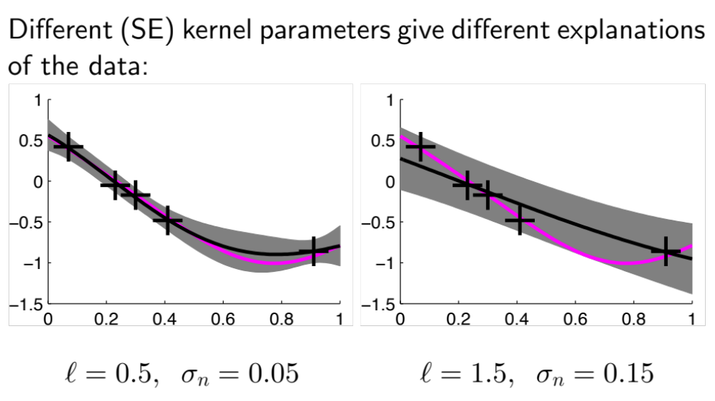
Gaussian Processes
Example of Kernels
Interpretation

Slide 33
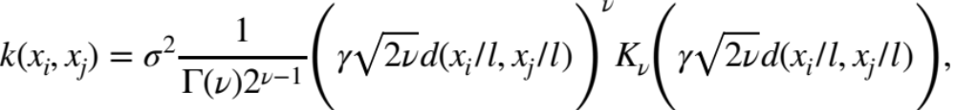
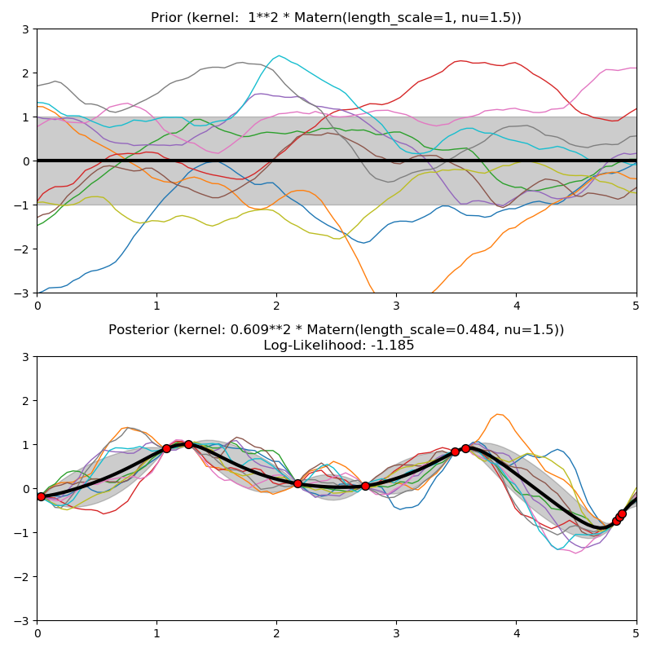
Gaussian Processes
Example of Kernels
Matérn kernel – generalize RBF kernel with smoothing parameter ν

Slide 34
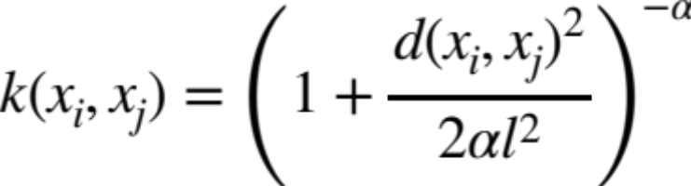
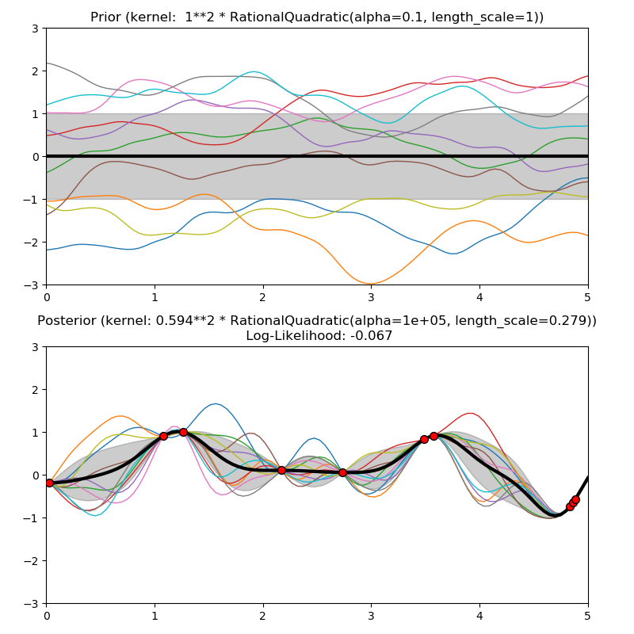
Gaussian Processes
Example of Kernels
Rational quadratic kernel – scale mixture (an infinite sum) of RBF kernels with different characteristic length-scales and mixture parameter α

Slide 35
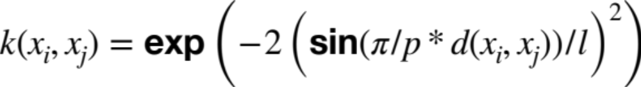
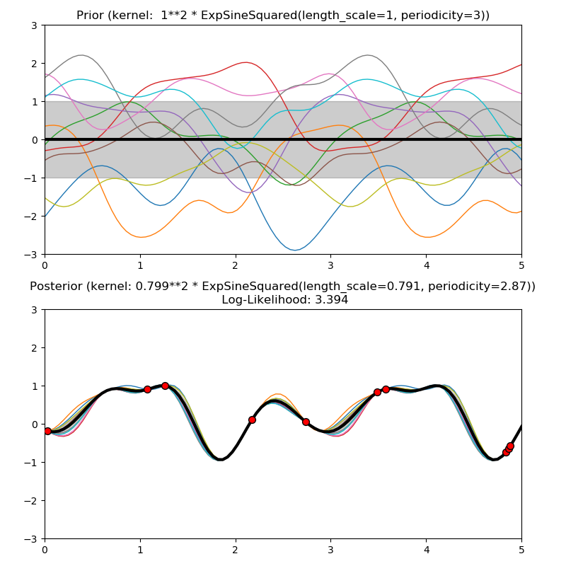
Gaussian Processes
Example of Kernels
Exp-Sine-Squared kernel – allows modeling periodic functions.

Slide 36
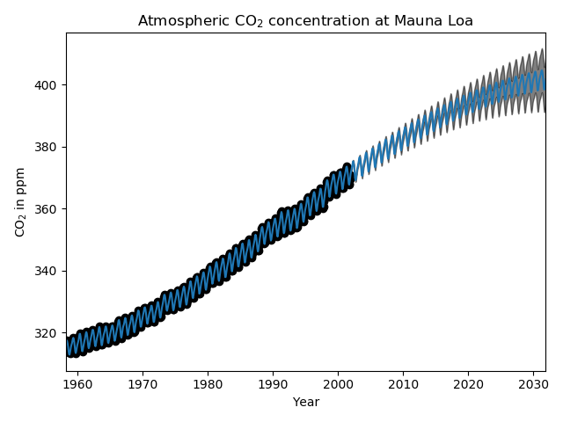
Gaussian Processes
Example of use: GPR on Mauna Loa CO2 data
Monthly average atmospheric CO2 concentrations (in parts per million by volume – ppm ) collected at the Mauna Loa Observatory in Hawaii, between 1958 and 1997
Kernel made of
a long term, smooth trend by an RBF kernel. The RBF kernel with a large length-scale enforces this component to be smooth (not necessarily rising)
a seasonal component, with Exp Sine Squared kernel with a fixed periodicity of 1 year. The length-scale of this periodic component, controlling its smoothness, is a free parameter.
smaller, medium term irregularities are to be explained by a Rational Quadratic kernel component
a “noise” term, consisting of an RBF kernel contribution, which shall explain the correlated noise components such as local weather phenomena, and a Constant contribution for the white noise. The relative amplitudes and the RBF’s length scale are further free parameters.

